Slide 1
Audio in Game Design
By: Gud Games Inc.

Slide 2

Importance of Music
Sounds, including music brings the player closer to what's happening on screen.
It gives the game a extra layer of life. Making a convincing virtual world.
Music can create atmosphere, reinforce emotion, convey meaning, and provide structure.

Slide 3
Worldbuilding
Grand scale orchestras can make the world feel massive and monumental (Dark Souls)
The soundtrack in the Fallout series paints a picture of the world before the nuclear war.
Creepy background music can make an eerie\sinister environment.
Cultural music for specific locations can make an area feel authentic. (Zydeco in New Orleans or other cultures that could be foreign)
Music can try to set the pace of the game.

Slide 4
Music and Moods
Ambient music that plays in the background usually isn't noticed but can set a mood for a specific environment.
Tense music can warn the player to stay alert, warning the player of an unseen threat.
Intense music can keep player in an alert state as a fight drags on longer than expected.
Music can help the player stay engaged longer in a game.
Imagine the Pokemon music as you enter a fight, it induces anxiety.

Slide 5
Dynamic Music
Imagine soundtracks that can change depending on how the user plays.
Deus Ex had different versions of the same location songs.
Ambient (exploration)
Stressed (stealth)
Hardfight (combat)
Doom(2016) focused on a songwriting approach where chords, transitions, and verses would play based on the speed of combat and intensity.

Slide 6
Science of Music on the Body
Sound processing begins in the brainstem, which also controls heart-rate and respiration.
What does this mean?
Our body reacts to music involuntarily.
Music can release dopamine, which makes people feel engaged and motivated.
Music can ease stress, pain, and anxiety. Factors such as familiarity and predictability in music increases the effects.
Source: https://www.health.harvard.edu/heart-health/tuning-in-how-music-may-affect-your-heart

Slide 7
What Makes Bad Music in Games
Simply put, good music succeeds in its goal of building atmosphere without getting in the way and bad music sticks out like a sore thumb and doesn't belong where its at.
Personally, it's hard to judge music. But music in a game should not overshadow the game itself, the soundtrack should complement the game’s theme and setting.

Slide 8
Reaction Time
Reaction time is the interval between stimulus and a voluntary response.
8-10ms for auditory stimulus to reach the brain.
20-40ms for visual stimulus to reach the brain.
Source: http://www.sjosm.org/article.asp?issn=1319-6308;year=2014;volume=14;issue=1;spage=35;epage=38;aulast=Ghuntla#ref13

Slide 9
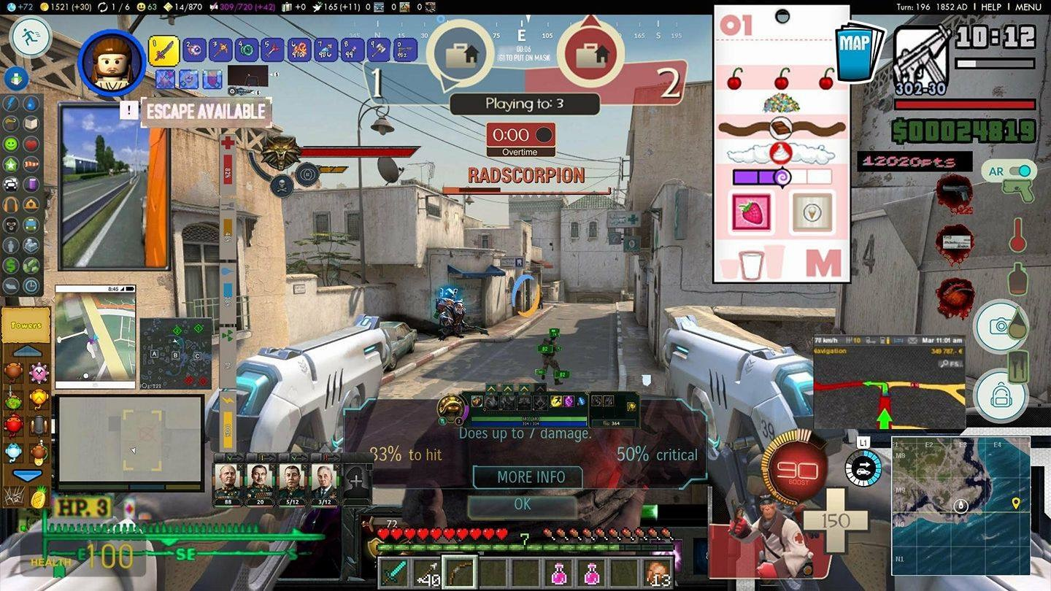
Visual Overload

Slide 10
Sound Cues
Information outside the FOV
What happened?
Where did it happen?
What did it happen to?

Slide 11
Sample Rate and Bit Depth

Slide 12

Audio
Sound is a wave
In order to digitally capture sound, we must convert it from the original analog audio to digital.
Digitally capturing sound creates an approximation of the wave rather than the actual wave.
This is why some prefer vinyl to CD because it is generally the most accurate representation of the recording

Slide 13
Sample Rate
Sample rate is the frequency that a sample is captured in order to replicate a sound
This rate is usually measured in KHz (How many thousand samples taken per second)
The more frequently we sample a sound, the better we are able to reproduce it

Slide 14
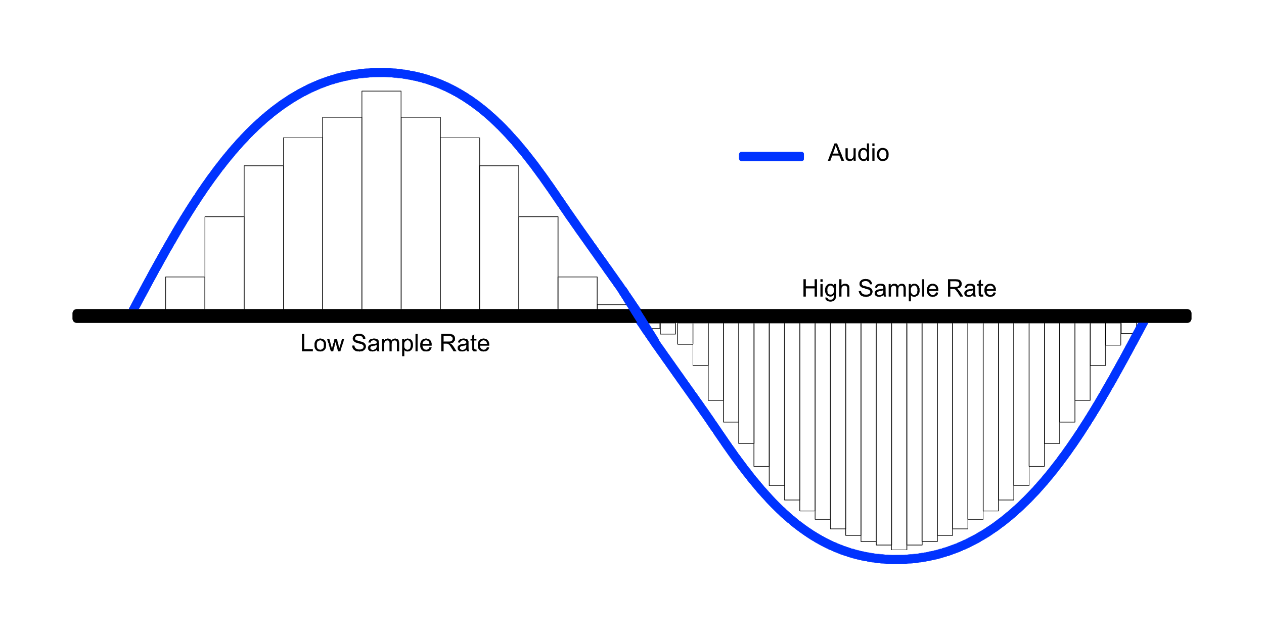
Sample Rate

Slide 15
Sample Rate Comparison

Slide 16
Bit Depth
Each sample captured is stored as a series of 1s and 0s. The amount of 1s and 0s is called the bit depth
Common audio bit depths are 16, and 24 bits
The more bits we have, the more accurately we can represent the sound

Slide 17
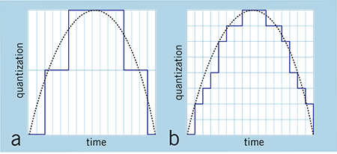
Bit Depth

Slide 18
Does Size Matter?

Slide 19
Counterexample: Does Size Matter?
When Might You Want Lower Bit Depth and Sample Rate?
When Size Matters!
Phone Games, Lots of Audio Files, ETC

Slide 20
Audio Files in Unity

Slide 21
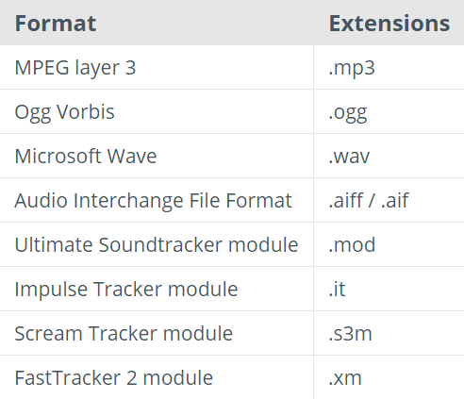
Unity Supports the following Audio File Types

Slide 22
MP3
MP3 gained popularity because its ability to be compressed. It made sharing easier and allowed for more songs to be stored.
MP3 compresses audio files by reducing accuracy of frequencies considered not perceptible by most human hearing.

Slide 23
WAV
Uncompressed, sound unaffected
Generally Higher Quality
Supported In Unity
Can be compressed and converted to MP3 if necessary

Slide 24
MP3 to WAV Comparison

Slide 25
File Conversion
Go to Freesound.org
VLC - Converting
Audacity - Editing

